Slide 1
Introduction to Angular
Quiz

Slide 2
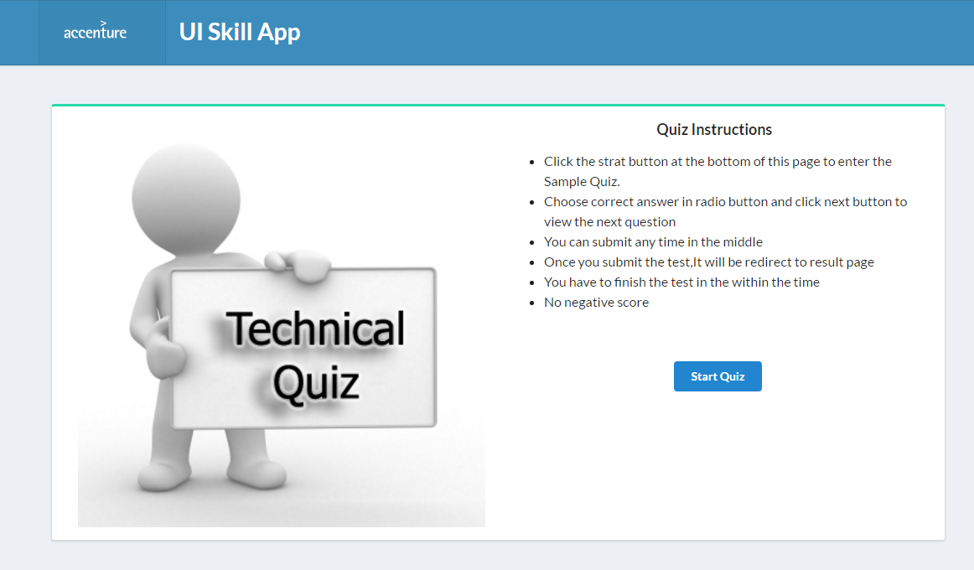
Quiz
Develop a simple quiz application.
Should be done in a group of 3 or 4.
On clicking takes to the next page

Slide 3
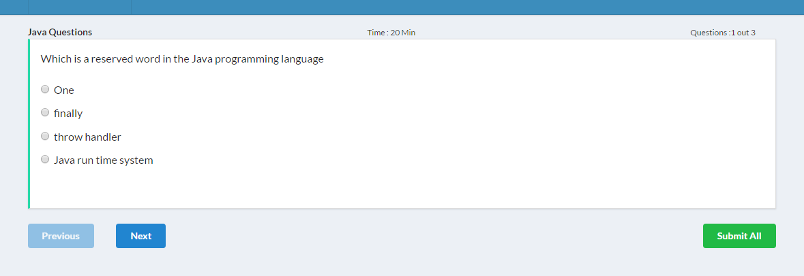
Quiz
Display the current question and total question
Previous Button is disabled

Slide 4
Quiz
On submission show the answers in a Popup or new page

Slide 5
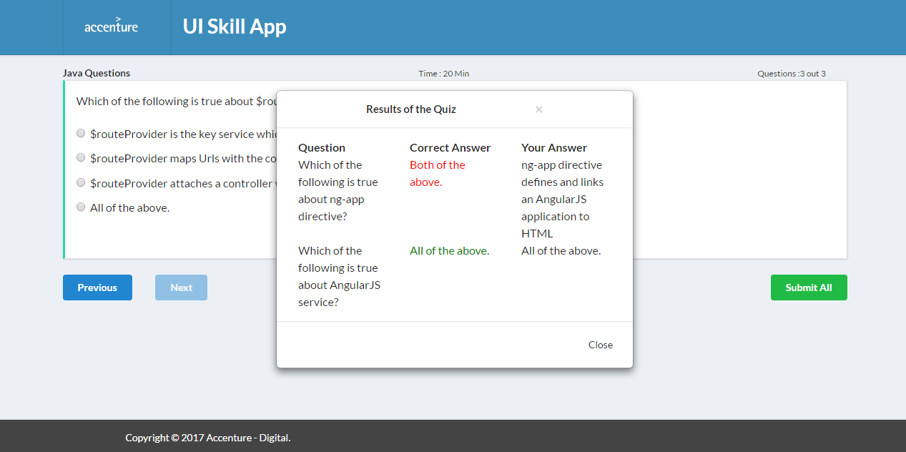
Quiz
Wrong answer red color
Correct answer green color

Slide 6
Quiz
Concepts to be used in this application
Components
Routing
Reactive Forms
Custom Events
Two way Data binding
Dependency Injection
Http Service and Observables

Slide 7

Thank you

